Slide 1


Accessibility Testing 101
Erissa Duvall – KCDC 2024

Slide 2
Disclaimer
While I may mention some examples from current/past jobs, I am not representing any of my employers during this presentation.
Additionally, while I will discuss some legislation, I am not a lawyer and nothing I say should be taken as definitive legal advice.

Slide 3
Overview
What is Accessibility?
The Spectrum of Disability
Why?
How to decide what is Accessible?
Importance of User Feedback & Experience
Building A11y Test Plans & Processes
Manual vs Automated
Tools & Resources

Slide 4
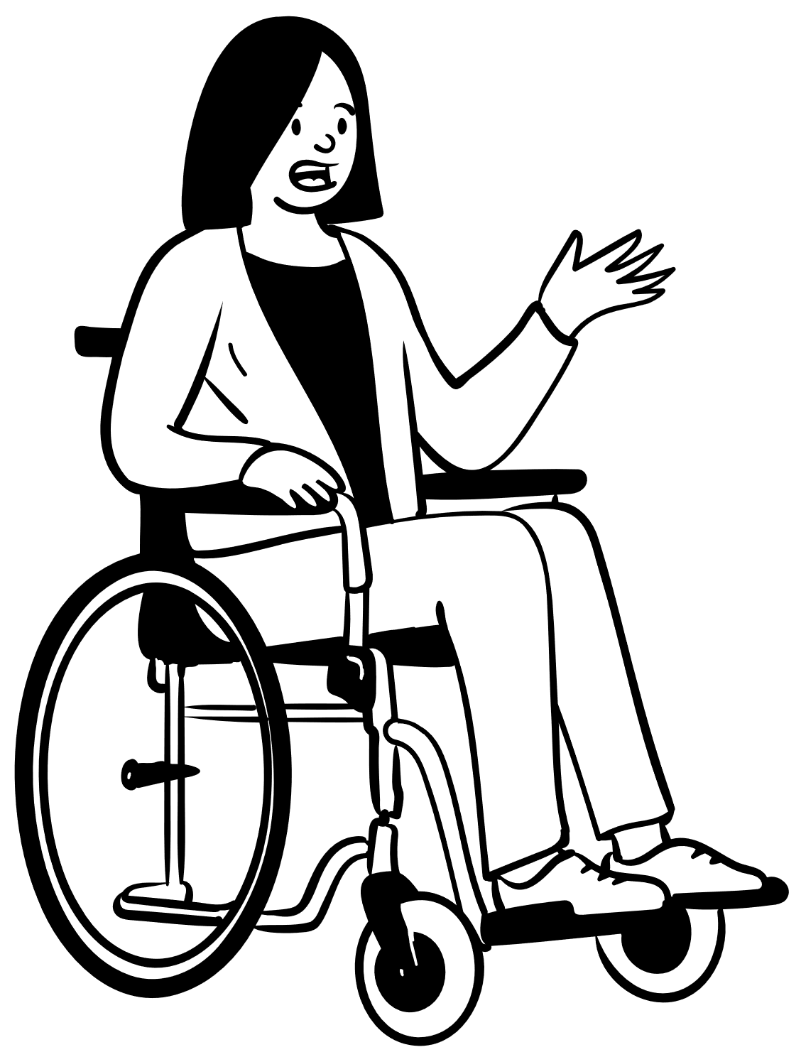
What is Accessibility?
Accessibility
Disability
Assistive / Adaptive Technology
Notes:
Accessibility – how well can your product be used by people of all abilities?
Disability – A disability is basically a mismatch in interaction between a person’s body and the features of their environment in which they live.
Not delving into specifics on this during this presentation, but the important things to remember are that:
Disabilities can impact more than one area of a person’s life
Just because 2 people are labeled as having the same disability does not mean that they will:
have the same presentation, OR
encounter the same barriers
Adaptive/Assistive Technology (AT) - is any item, piece of equipment, software program, or product that is used to increase, maintain, or improve the functional capabilities of people with disabilities.

Slide 5

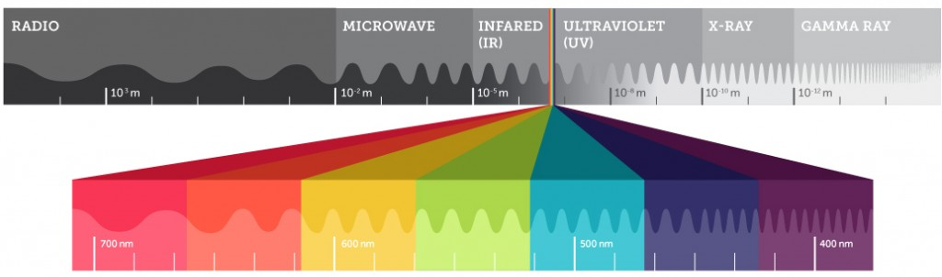
The Spectrum of Disability
Notes:
We tend to see numbers like 25/26% or 1 in 4 thrown around when discussing how many people have a disability, which is a massive amount, especially when you consider that there are over 7.8 billion people in the world.
However, disability is more akin to the Electromagnetic spectrum. Especially because not all disability is obvious or visible. Much of it is unseen or difficult to perceive. Some of it is more obvious to people who are more sensitive to it. For example, you often hear that individuals who are neurodivergent will flock together and recognize one another quicker than those who are not.
The image is sourced from the following article, When the Invisible Becomes Visible | Possibility | Teledyne Imaging (https://possibility.teledyneimaging.com/invisible-becomes-visible/).

Slide 6


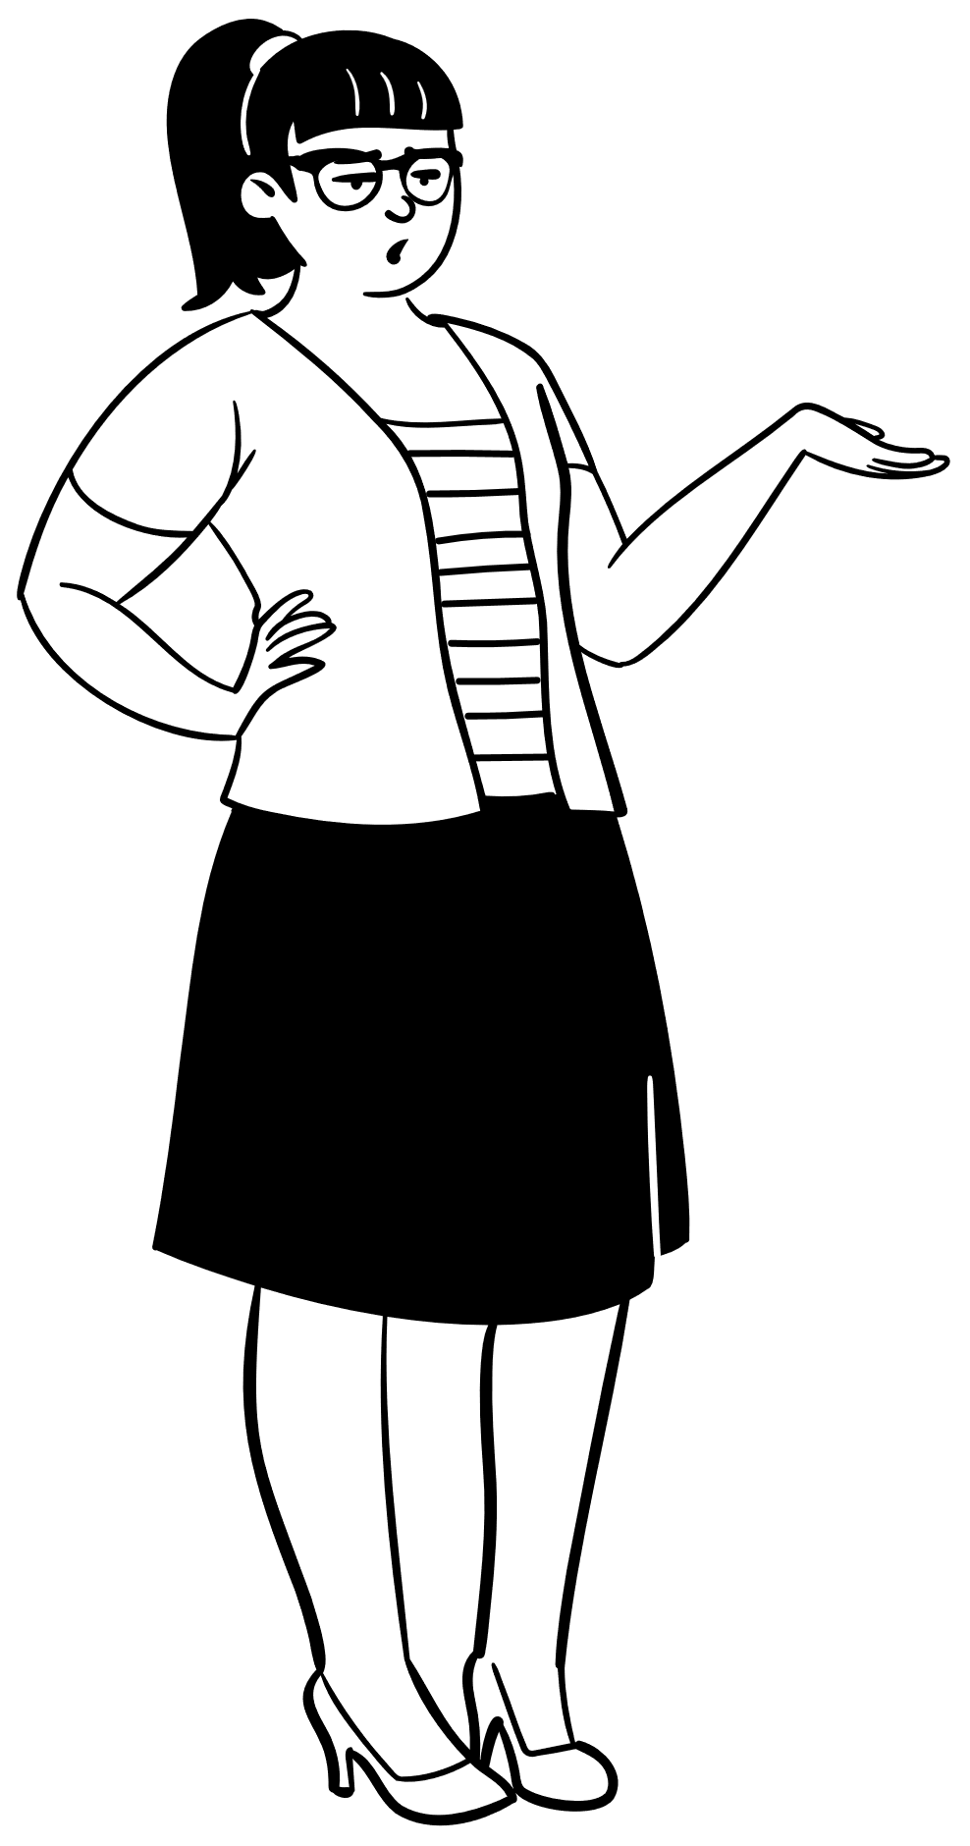
Why?
Accessibility helps to:
Remove barriers
Allow equal access
Through that we create an environment that:
Feels more welcoming
Encourages diversity
Helps people make informed decisions
Encouraging innovation / productivity / progress
Expand our market / audience
Notes:
By creating an experience where people can all access the same information and services, we remove barriers. Through that help everyone:
make more informed choices for themselves and their communities
feel more welcome (employee/customer retention)
encourage diversity in our communities and workplaces
encourage innovation and progress
avoid missing out on the market
A Hidden Market: The Purchasing Power of Working-Age Adults With Disabilities | American Institutes for Research (air.org)
Article URL: https://www.air.org/resource/report/hidden-market-purchasing-power-working-age-adults-disabilities
`The total disposable income for U.S. adults with disabilities is about $490 billion, which is comparable to other significant market segments, such as African Americans ($501 billion) and Hispanics ($582 billion). (Disposable income is what is left after taxes are paid.); and Discretionary income for working-age people with disabilities is about $21 billion, which is greater than that of the African-American ($3 billion) and Hispanic ($16 billion) market segments, combined. (Discretionary income is the money remaining after deducting taxes, other mandatory charges, and spending on necessities, such as food and housing.”

Slide 7


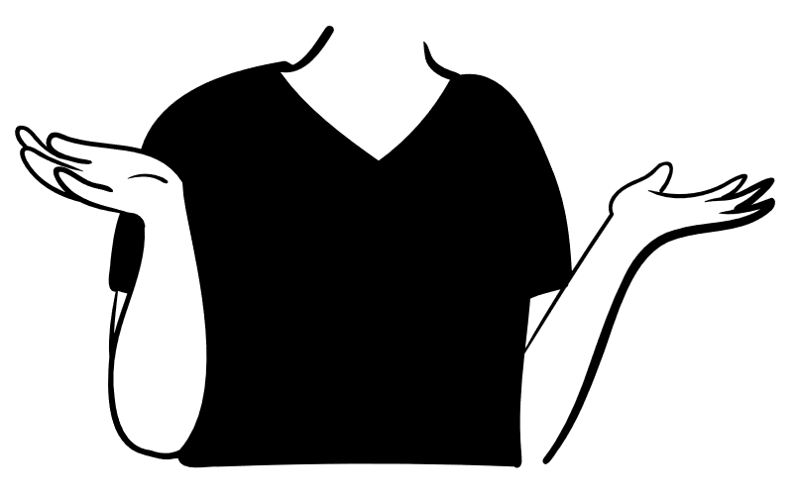
How to decide what is accessible?
Regulations / Policies
Equality Act 2010 (EQA)
European Accessibility Act (EAA)
Accessibility for Ontarians with Disabilities Act (AODA)
Americans with Disability Act of 1990 (ADA)
Learn more at: Web Accessibility Laws & Policies | WAI | W3C
Guidelines / Standards
Web Content Accessibility Guidelines (WCAG)
International Standards Organization (ISO)
Portable Document Format / Universal Accessibility (PDF / UA)
Accessible Electronic Documents Community of Practice (AED CoP)
Experience
User Feedback
Notes:
US Regulations:
Americans with Disabilities Act (ADA)
Section 508 of the Rehabilitation Act of 1973 (USA)
Section 255 of the Communications Act (USA)
UK / EU Regulations
Equality Act 2010 (EQA)
Public Sector Bodies (Websites and Mobile Applications) (No. 2) Accessibility Regulations 2018
European Accessibility Act (EAA)
Canada Regulations
Accessibility for Ontarians with Disabilities Act (AODA)
US Guidelines/Standards
Accessible Electronic Documents Community of Practice (AED COP) – Guidelines and testing instructions for ensuring accessible documents that are Section 508 compliant.
World Wide Web Consortium (W3C) Guidelines include:
Authoring Tools Accessibility Guidelines (ATAG)
User Agent Accessibility Guidelines (UAAG)
Accessible Rich Internet Applications (ARIA)
ISO Standards:
ISO/IEC Guide 71: Guide for addressing accessibility in standards
ISO/TR 22411: Ergonomics data for use in the application of ISO/IEC Guide 71:2014
ISO 30071-1: Digital accessibility standard
ISO 21542: Building construction — Accessibility and usability of the built environment

Slide 8
Quick Warning!
Possible pseudo flashing effect due to image on next slide.
Notes:
US Regulations:
Americans with Disabilities Act (ADA)
Section 508 of the Rehabilitation Act of 1973 (USA)
Section 255 of the Communications Act (USA)
UK / EU Regulations
Equality Act 2010 (EQA)
Public Sector Bodies (Websites and Mobile Applications) (No. 2) Accessibility Regulations 2018
European Accessibility Act (EAA)
Canada Regulations
Accessibility for Ontarians with Disabilities Act (AODA)
US Guidelines/Standards
Accessible Electronic Documents Community of Practice (AED COP) – Guidelines and testing instructions for ensuring accessible documents that are Section 508 compliant.
World Wide Web Consortium (W3C) Guidelines include:
Authoring Tools Accessibility Guidelines (ATAG)
User Agent Accessibility Guidelines (UAAG)
Accessible Rich Internet Applications (ARIA)
ISO Standards:
ISO/IEC Guide 71: Guide for addressing accessibility in standards
ISO/TR 22411: Ergonomics data for use in the application of ISO/IEC Guide 71:2014
ISO 30071-1: Digital accessibility standard
ISO 21542: Building construction — Accessibility and usability of the built environment

Slide 9


Importance of User Feedback & Experience
Notes:
“The original Disability Pride flag was created in 2019 by writer Ann Magill, who has cerebral palsy.”
“The flag featured brightly colored zigzagging stripes over a black background. The zigzag represented how people with disabilities have to maneuver around all the barriers they face.
However, when viewed on the phone or a device, the design prompted symptoms in individuals with visually triggered disabilities. At the same time, the community offered suggestions.”
“The flag is considered a collaborative design effort, with Magill saying the new design truly represents the represents the community because the community came together to solve a problem.”
The above information was sourced from:
History of the Disability Pride Flag | Weinberg Family Cerebral Palsy Center | Columbia University Irving Medical Center
https://www.weinberg.cuimc.columbia.edu/news/history-disability-pride-flag

Slide 10

Building A11y Test Plans & Processes
Start with Guidelines
Shift left and include throughout
Nothing without us
Manual and Automated
Screen reader and Keyboard accessible
Avoid “it works on my machine”
Learn from the experience of others
Notes:
Example Test Methods/Plans:
VGAR – Visa Global Accessibility Requirements
URL: https://developer.visa.com/pages/accessibility
Section 508 ICT Testing Baseline for Web
This Baseline identifies the minimum requirements of any test process used to determine conformance of web content with the Revised Section 508 of the Rehabilitation Act of 1973, as amended (29 U.S.C. 794d)
URL: https://ictbaseline.access-board.gov/
BBC Accessibility Help
URL: https://www.bbc.co.uk/accessibility/
aXe DevTools & Accessibility Insights by Microsoft have manual test plans included in their tools as guided manual testing.

Slide 11
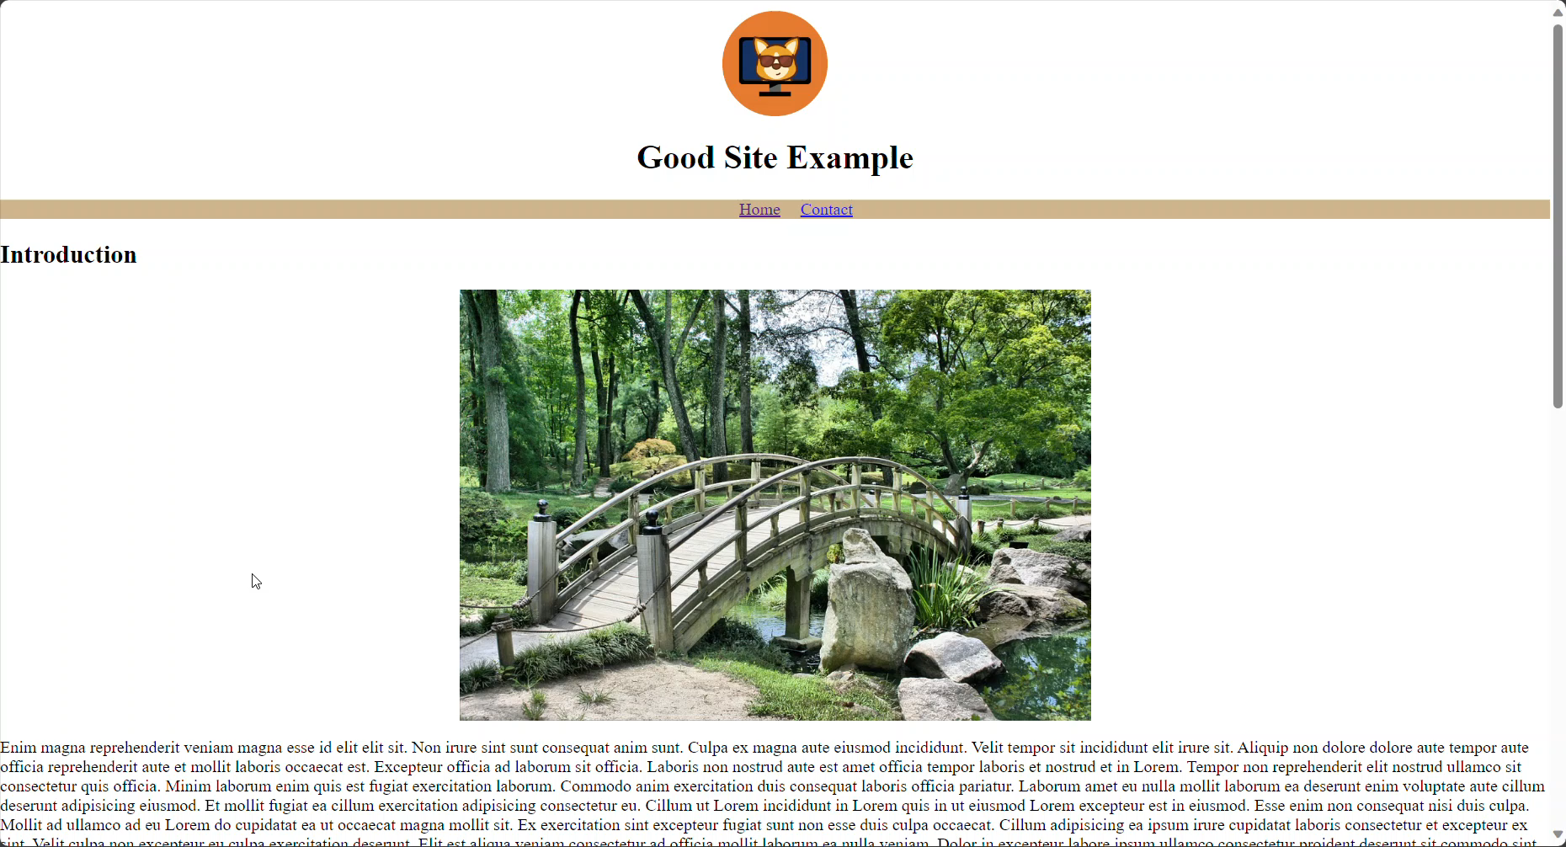
Manual vs Automated
Notes:
Video showing 3 copies of the same site. The first has proper semantic HTML, (heading levels, landmark regions, etc.) sufficient alt values for images, and it is labeled as the "Good Site". The second is a "Bad Site" example. It looks visually like the Good site, but it does not use semantic HTML and just has styles applied to make it visually look the same. The third site has no styles, no semantic HTML, and looks like a horrible dumpster fire. All 3 score 100% on aXe DevTools and other automated Accessibility checks.

Slide 12
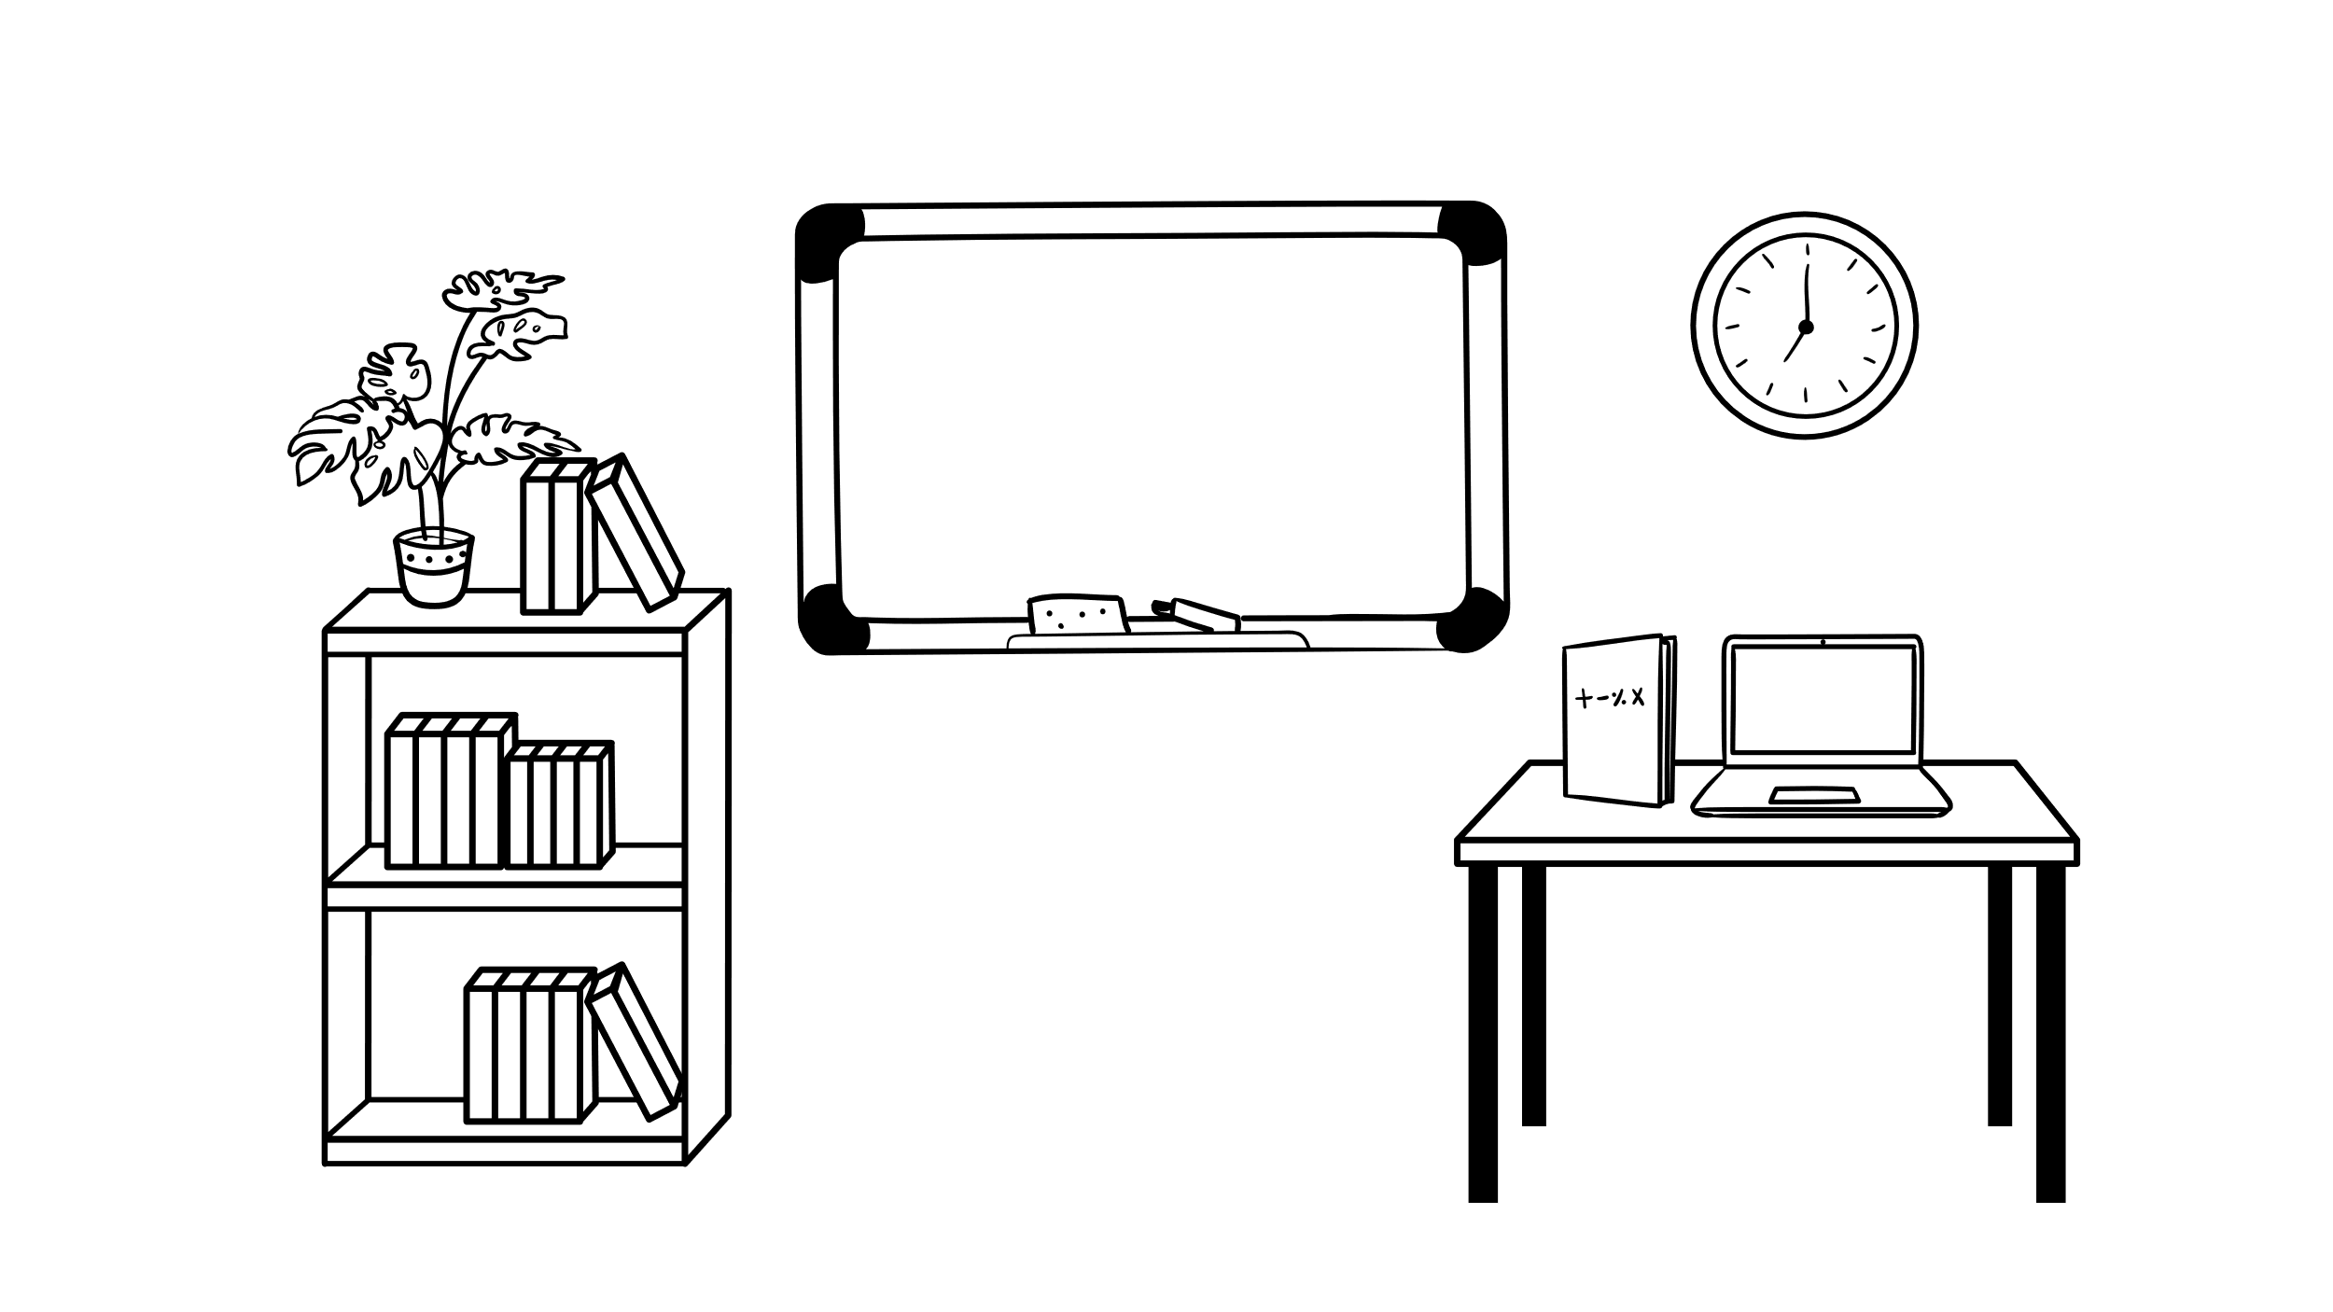


Tools & Resources
Built into your Operating Systems (OS)
MacOS & Windows
Built into your Browser
Edge & Firefox
Desktop Applications
Browser Extensions & Web Apps
Bookmarklets
Books
Additional Resources

Slide 13
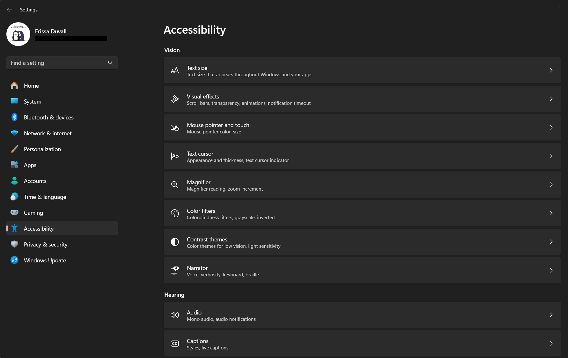
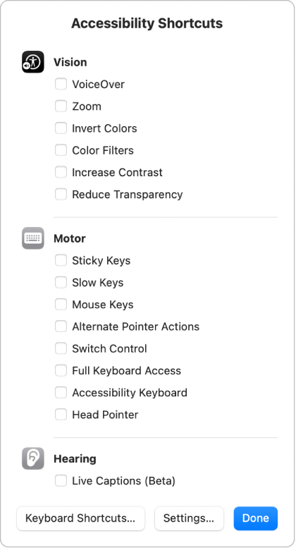
Built into your OS
Notes:
Microsoft and MacOS have a variety of built in accessibility options that help you zoom, have narration, use color filters and more to make a system more accessible based on your needs or test for accessibility in your content.
Additionally, there are keyboard shortcuts that help you turn accessibility features on/off quickly as needed.

Slide 14
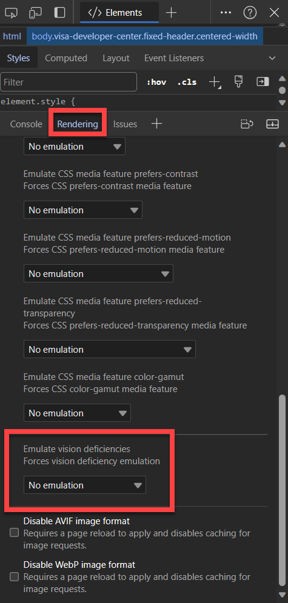
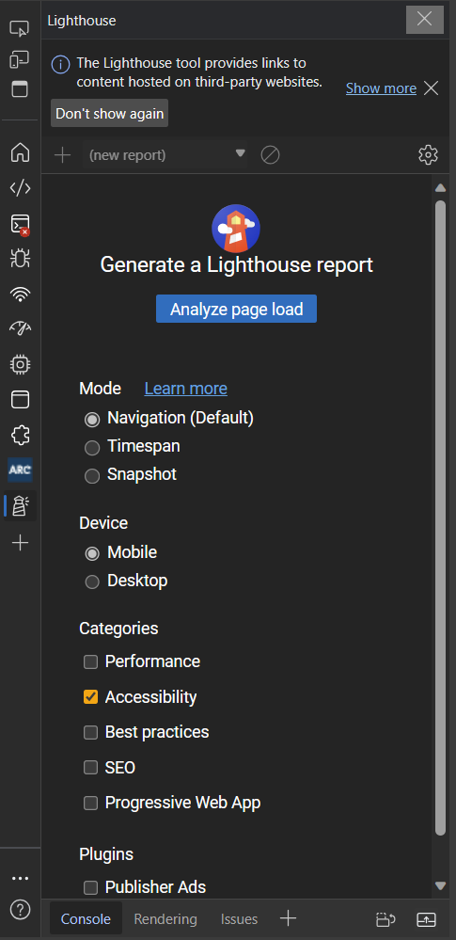
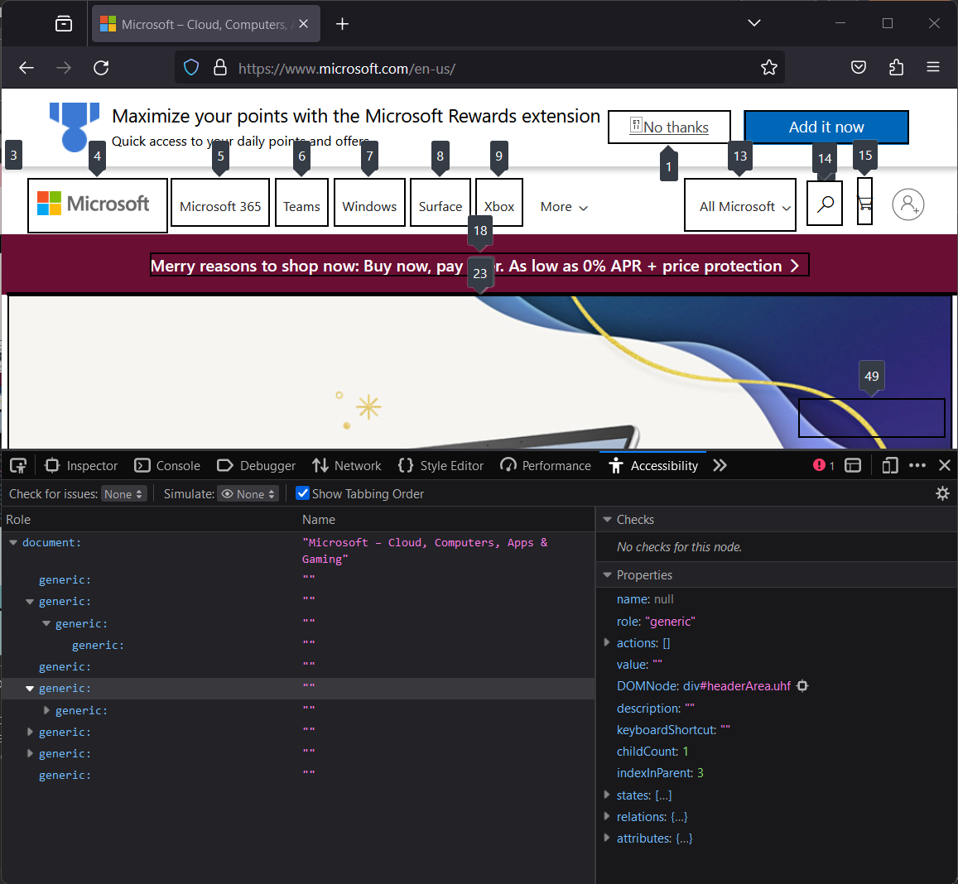
Built into your Browser
Notes:
Lighthouse is built into Chromium based browsers like Google Chrome and Microsoft Edge. It allows you to check Accessibility, SEO, and performance impacting elements of a page.
Firefox has similar options, but they are separated out into individual scanners, rather than under one option.
The rendering options are also built into Chromium browsers. They allow you to get an idea for how some disabilities may view your page and see how various custom CSS options may impact your site appearance and behavior.

Slide 15
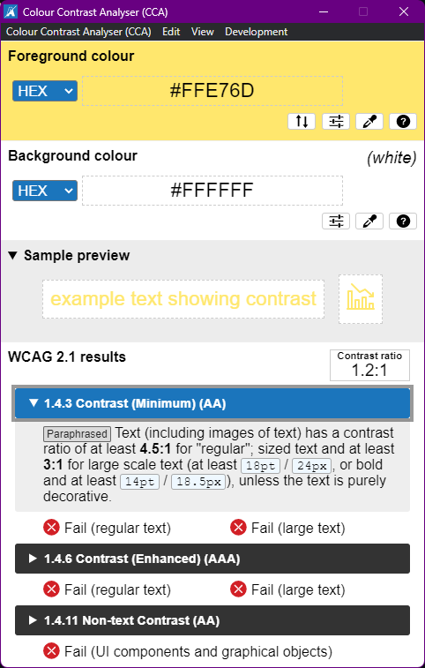
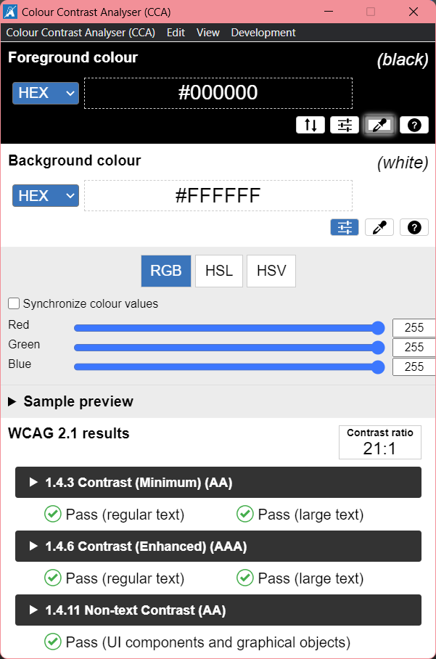
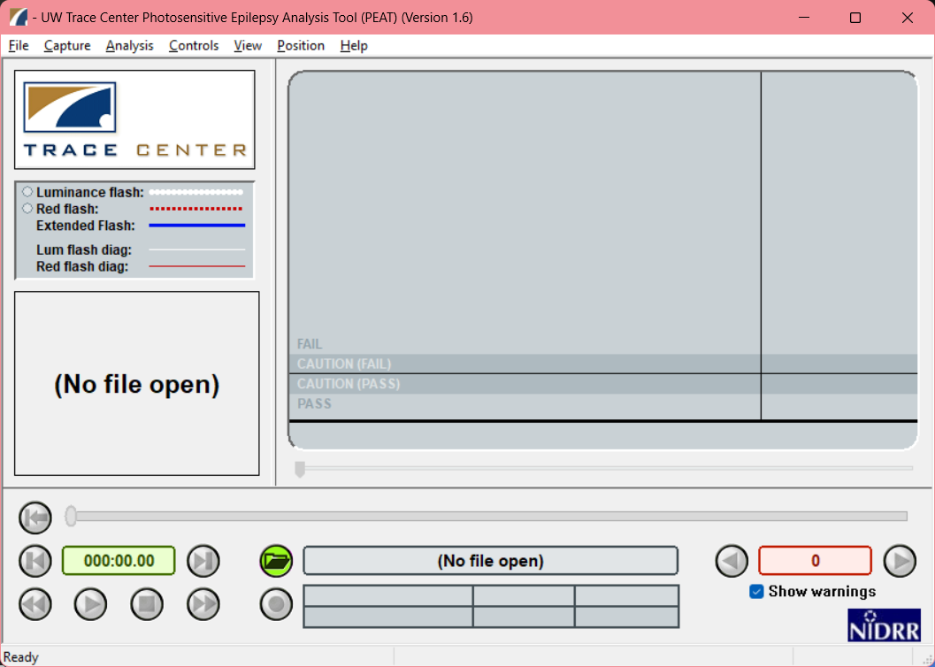
Desktop Applications: CCA & PEAT
Notes:
These are installable desktop applications:
Color Contrast Analyzer by TPGi - https://www.tpgi.com/color-contrast-checker/
Photosensitive Epilepsy Analysis Tool (PEAT) by the Trace Center - https://trace.umd.edu/peat/

Slide 16
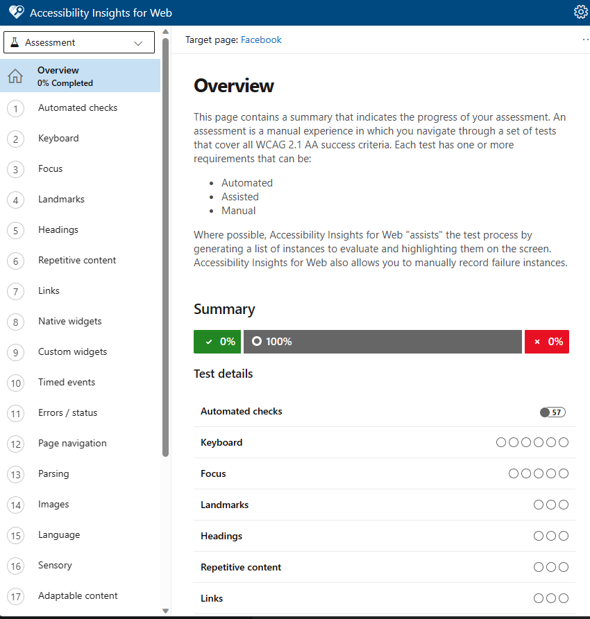
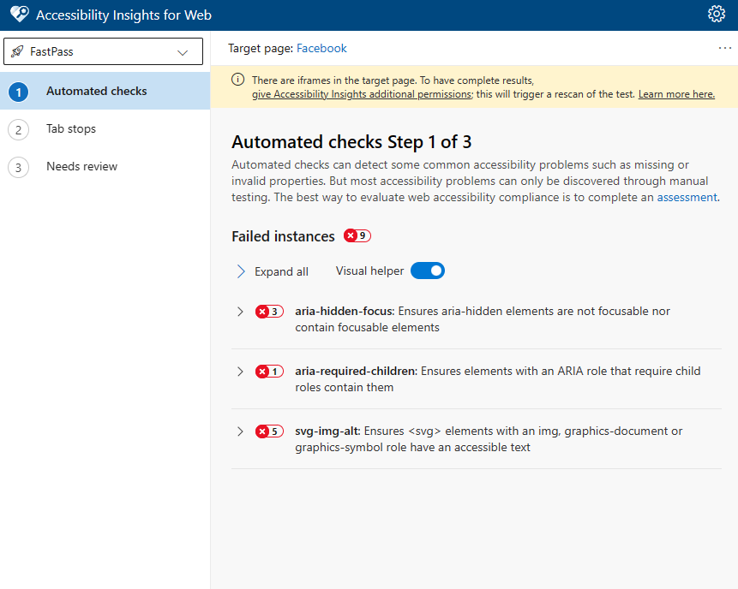
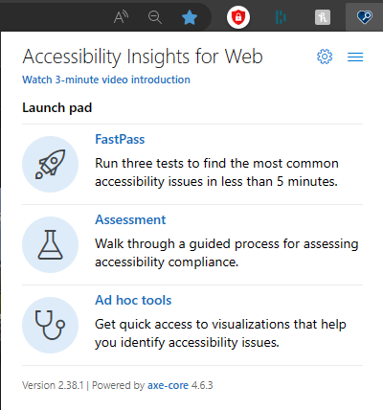
Browser Extensions & Web Apps: Microsoft Accessibility Insights
Notes:
Accessibility Insights is an open-source application developed by Microsoft and based off Axe Core.
Available as a desktop application and a browser extension.

Slide 17
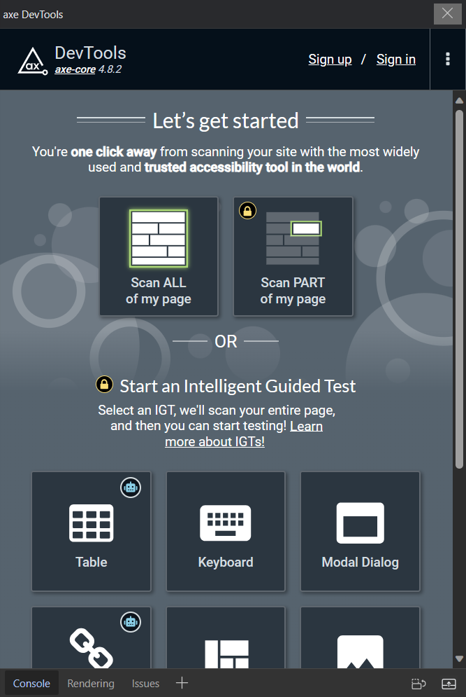
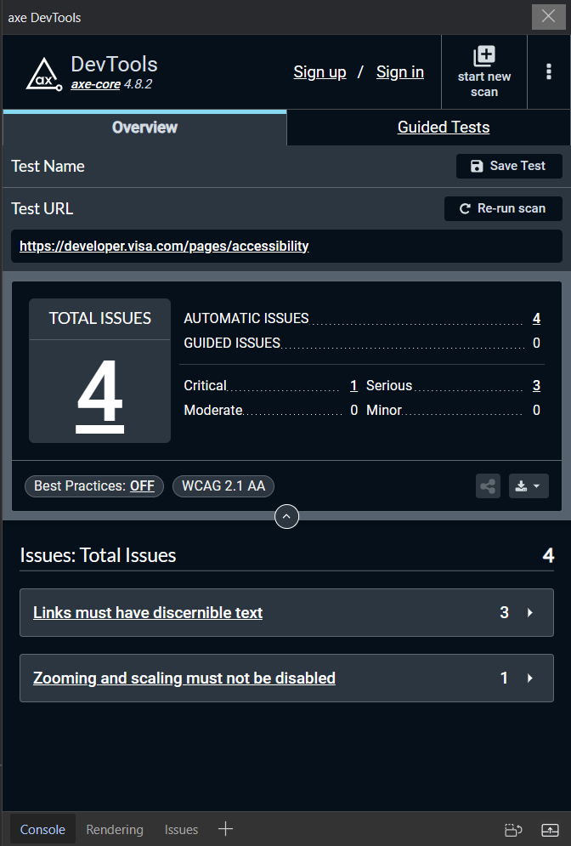
Browser Extensions & Web Apps: Deque Axe DevTools
Notes:
Axe DevTools (Can use forever for free. Pro just offers some extra testing features.) - https://www.deque.com/axe-devtools-accessibility-testing/

Slide 18
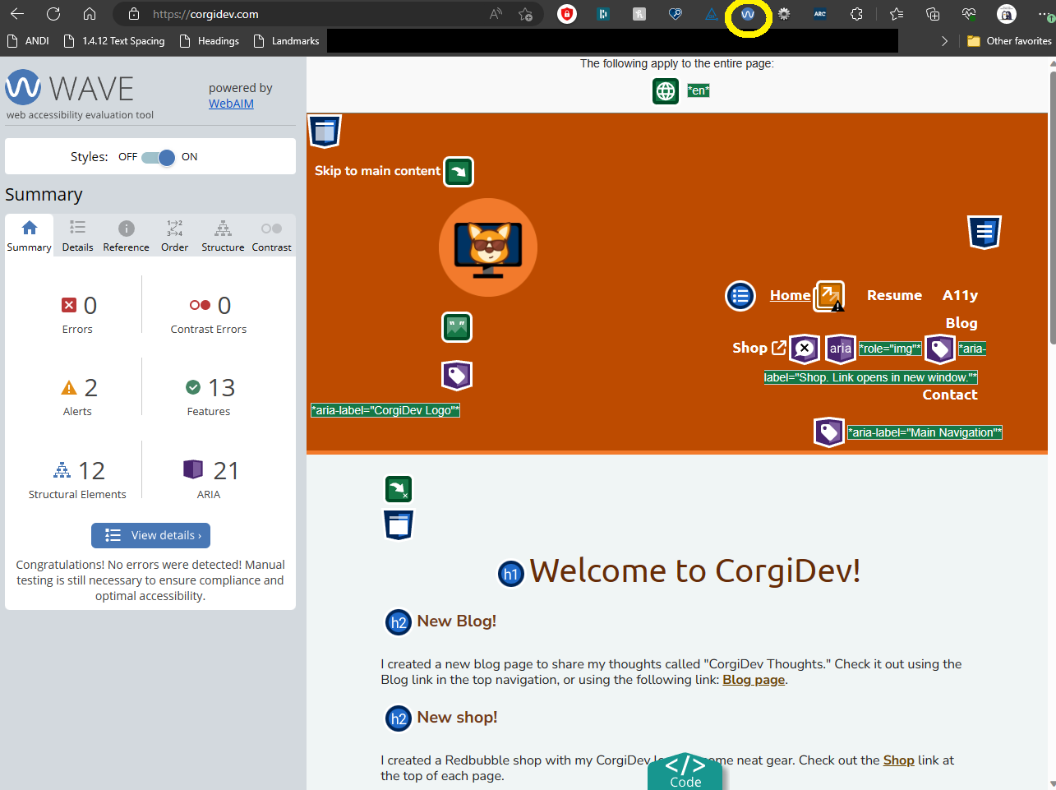
Browser Extensions & Web Apps: WAVE
Notes:
WAVE Chrome, Firefox, and Edge Extensions (webaim.org): https://wave.webaim.org/extension/

Slide 19
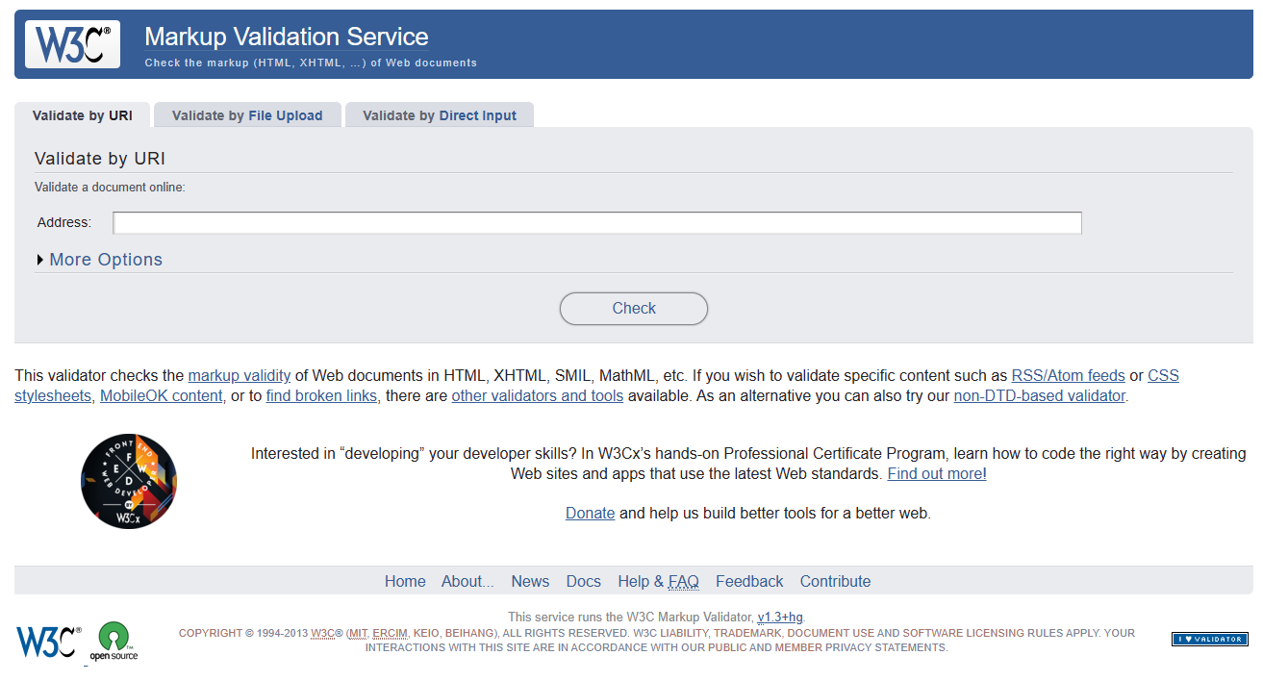
Browser Extensions & Web Apps: W3C Markup Validation Service
Notes:
The W3C Markup Validation Service - https://validator.w3.org/

Slide 20
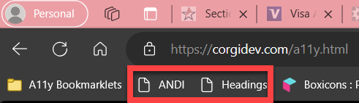
Bookmarklets
Find Landmarks on Web Page with A11Y Bookmarklet | HolisticA11Y
Forms Bookmarklet for Accessibility Testing (pauljadam.com)
ARIA Bookmarklet for Accessibility Testing (pauljadam.com)
Text spacing bookmarklet - Bookmarklets (dylanb.github.io)
Assorted Accessibility Bookmarklets for Landmarks, Headings, and more: Accessibility Bookmarklets (accessibility-bookmarklets.org)
ANDI - Accessibility Testing Tool - Install (ssa.gov)

Slide 21
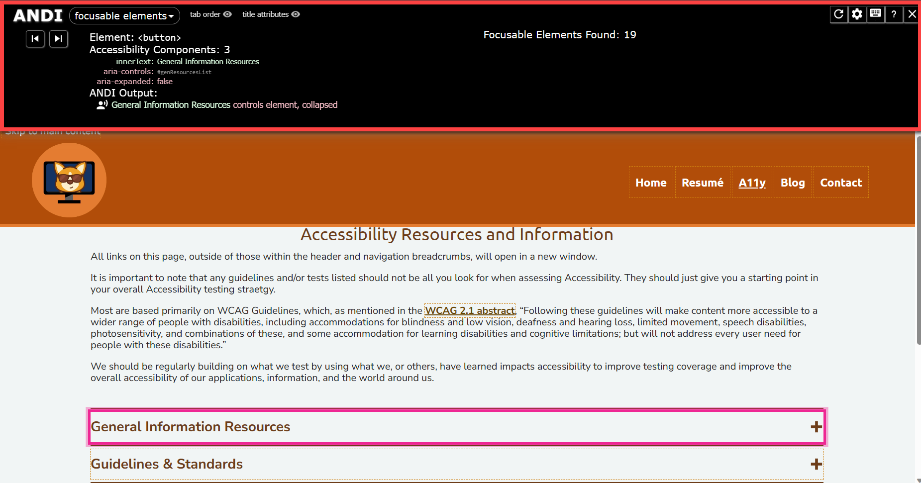
ANDI Bookmarklet
Notes:
ANDI stands for Accessible Name & Description Inspector and is a bookmarklet developed by the Social Security Administration (SSA).
ANDI URL: https://www.ssa.gov/accessibility/andi/help/install.html

Slide 22
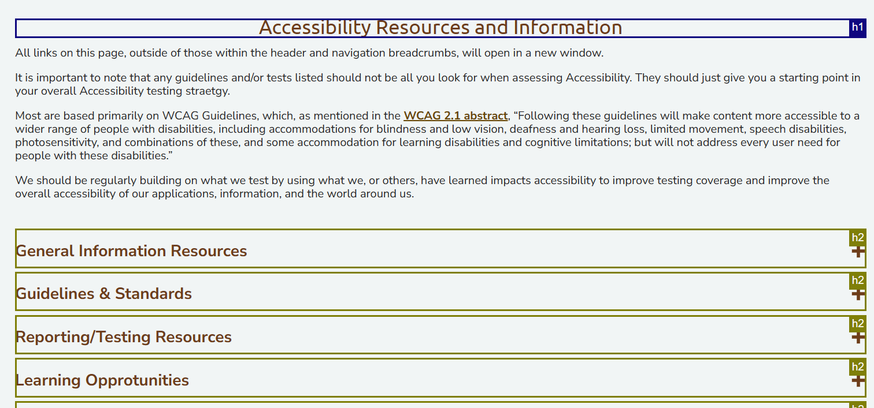
Headings Bookmarklet
Notes:
Headings Bookmarklet - https://accessibility-bookmarklets.org/install.html

Slide 23
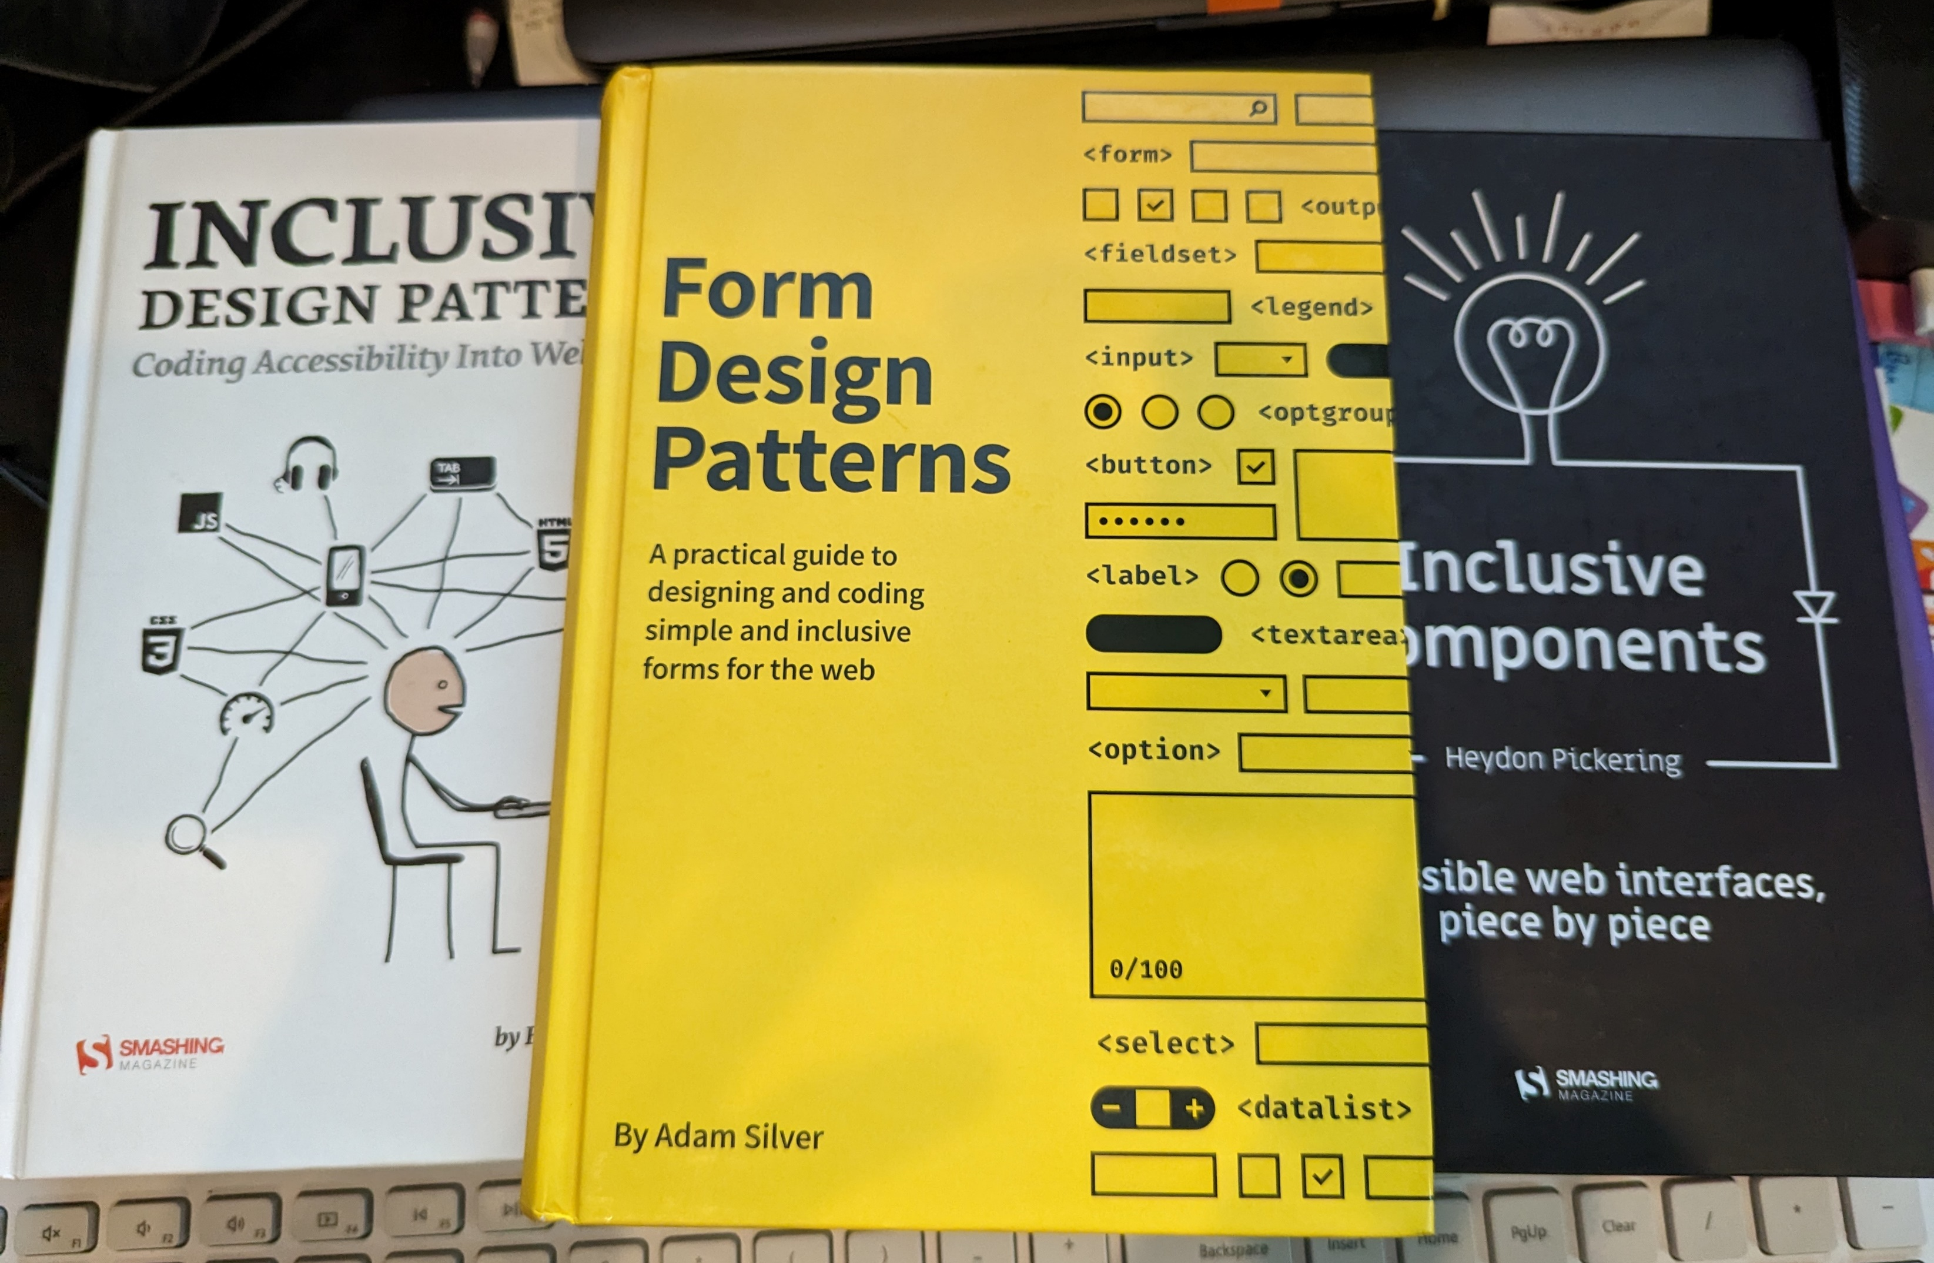
Books

Slide 24
Additional Resources
Accessibility Insights – Accessibility testing tool made by Microsoft
Has browser extension and desktop application versions
Also have the option to include the automated tests in CI/CD
DON’T depend on automated tests
Screen reader
NVDA – free, open-sourced screen reader
View keyboard shortcuts on at the Deque article entitled: NVDA Keyboard Shortcuts.
Narrator – screen reader built-in to Windows.
View keyboard shortcuts for Narrator in the Deque article entitled Narrator Keyboard Shortcuts.
VoiceOver – is a built screen reader found on iOS and MacOS devices.
TalkBack – is a built screen reader found on iOS and MacOS devices.
Microsoft Accessibility on Twitter at @MSFTEnable and at on the Microsoft Accessibility page.
Microsoft Accessibility Fundamentals course
ANDI – Bookmark applet developed by the Social Security Administration to aid in Accessibility testing.
Accessibility - Erissa Duvall (corgidev.com)

Slide 25
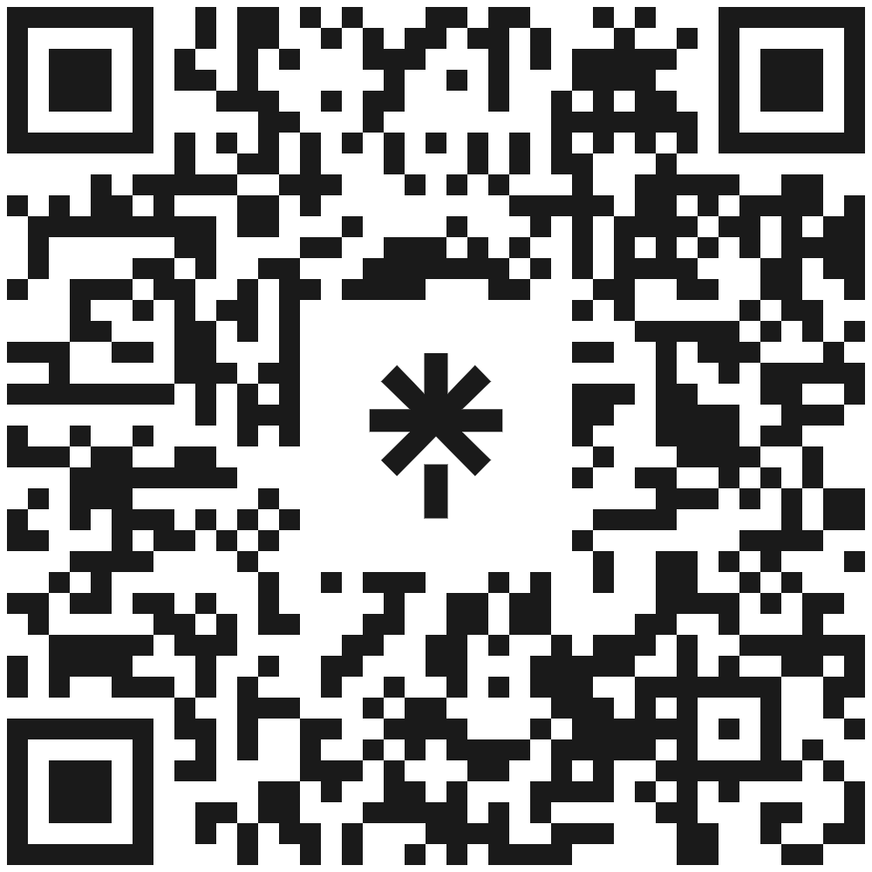
Thank You!
Questions?
linktr.ee/corgidev

